Slide 1
Introduction
In this project we will be analyzing some metrics of the World’s demographic trends.
Internet Usage
Birth Rate
Fertility Rate
Life Expectancy At Birth

Slide 2
Brief Definitions of the metrics
Birth Rate is the number of live births per thousand of population per year. The number of live births is normally taken from a universal registration system for births.
Internet Usage is basically the percentage of people having access to the internet.

Slide 3
Brief Definitions of the metrics
Not to be confused with birth rate.
The total fertility rate (TFR), sometimes also called the fertility rate of a population is the average number of children that would be born to a woman over her lifetime if:
She was to experience the exact current age-specific fertility rates (ASFRs) through her lifetime
She was to live from birth until the end of her reproductive life

Slide 4
Brief Definitions of the metrics
Life expectancy at birth is defined as the average number of years that a newborn could expect to live if he or she were to pass through life subject to the age-specific mortality rates of a given period.

Slide 5
First Task
We are required to produce :
A scatter-plot illustrating Birth Rate and Internet Usage statistics by Country categorized by Countries’ Income Groups.
And a second scatter-plot also illustrating Birth Rate and Internet Usage statistics by Country categorized by Countries’ Regions.

Slide 6
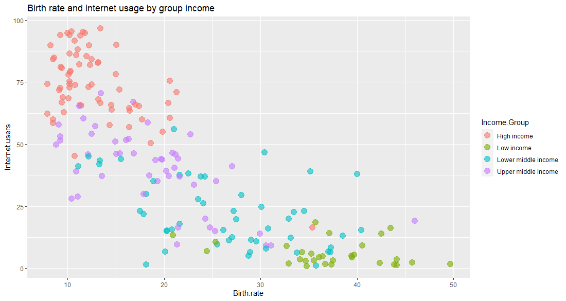

Slide 7
Insights
In the previous plot we can see that there is a negative correlation between Birth Rate and Internet Usage. Meaning that as we increase the internet usage it is likely to see a low birth rate country. And vise versa.
We can also derive that High income Groups of Countries are characterized by a high internet usage and a a low birth rate, while low income Groups of Countries Have very low Internet usage and a significant birth rate. Other income Groups of country are everything in between ( medium internet usage vs medium birth rate )

Slide 8
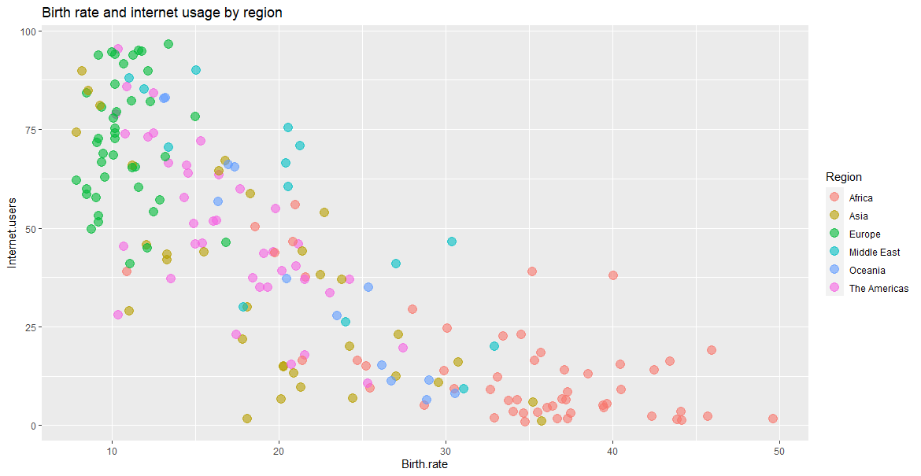

Slide 9
Insights
In this plot we have exactly the same distribution of the data as in the previous scatter-plot ( slide 3 ) but we have a different categories.
So in this plot we can see for instance the difference between Europe and Africa. Where Europe is characterized with a low birth rate and high internet usage rate, And for Africa… you guessed it.
I also made a bonus scatter-plot to visualize
Birth rate mean ~ Internet Usage mean By Region, in an attempt to make it easier to see where every Region falls in the distribution. (See next slide)

Slide 10
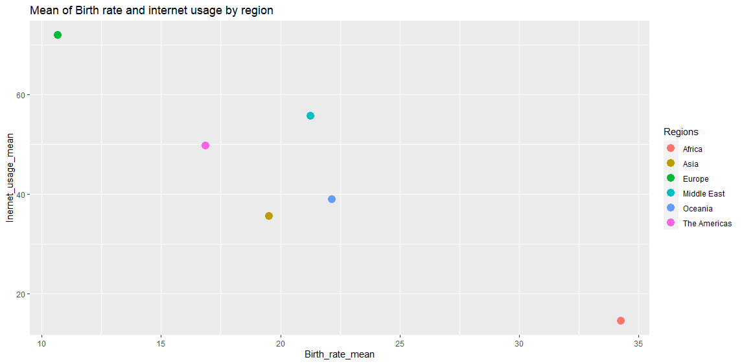
Note : using facets is a more effective tool to make a better insight

Slide 11
Second Task
We have been supplied with data for 2 years: 1960 and 2013 and we are required to produce a visualization for each of these years.
Some data has been provided in a .csv file and in R vectors. The csv file contains combined data for both years. All data manipulations have to be performed in R (not in excel) because this project may be audited at a later stage.
We have also been requested to provide insights into how the two periods compare.
We are required to produce a scatter-plot depicting Life Expectancy (y-axis) and Fertility Rate (x-axis) statistics by Country.
The scatter-plot needs to also be categorized by Countries’ Regions.

Slide 12
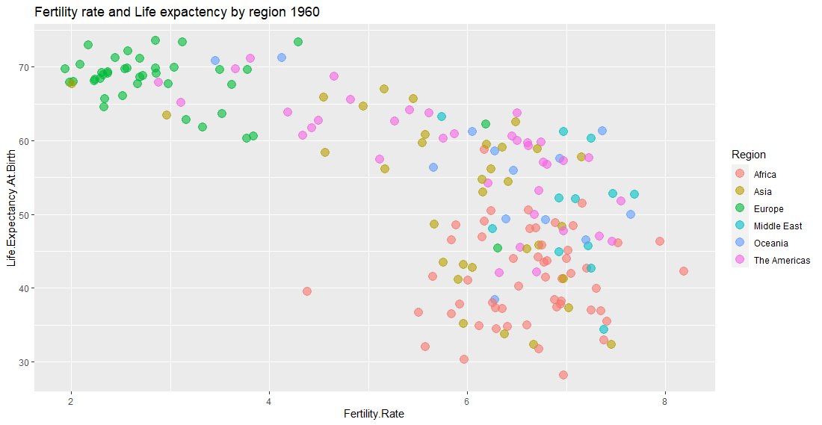

Slide 13
Insights
In the last slide we saw a plot describing Life Expectancy and Fertility Rate statistics by Country for the year 1960.
In this scatter-plot we can see that the two metrics are approximately negatively correlated,Meaning of course that countries where the Fertility Rate is relatively low are characterized by a significant Life Expectancy at birth percentage

Slide 14
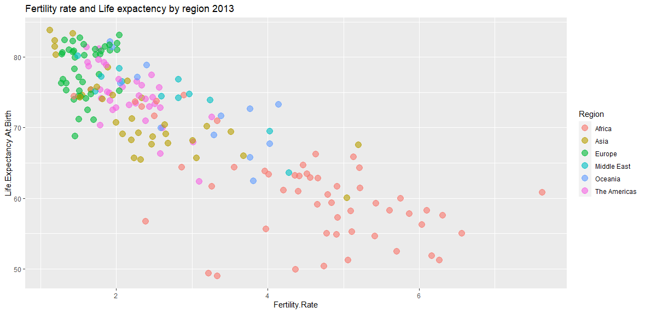

Slide 15
Insights
In the last slide we saw a plot describing Life Expectancy and Fertility Rate statistics by Country for the year 2013 categorized by Regions.
In this scatter-plot we can see that the two metrics are strongly negatively correlated,Meaning that as we decrease the Fertility rate of our Observations we will be seeing countries where Life Expectancy is more and more significant. And Vice Versa.

Slide 16
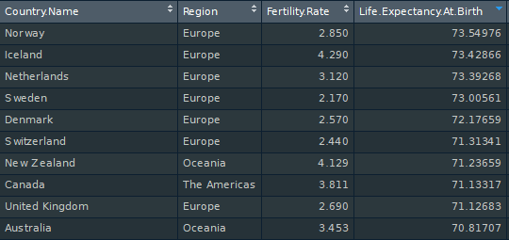
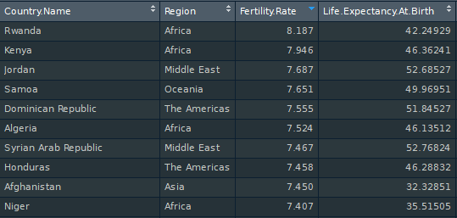
Example : Top 10
1960
Top 10 Countries by Life Expectancy at Birth
Top 10 Countries by Fertility Rate

Slide 17
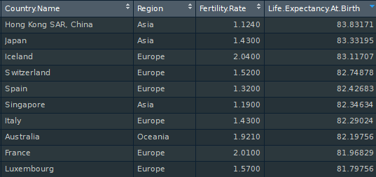
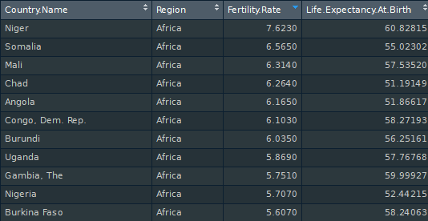
Example : Top 10
2013
Top 10 Countries by Life Expectancy at Birth
Top 10 Countries by Fertility Rate

Slide 18
Bonus
At this point we can observe how these two metrics of the Global data is behaving.
Although we would like to observe the changes for each Region from 1960 to 2013.
In order to make conclusions about regions, we might need to illustrate each region by itself and compare the two period for each one.

Slide 19
In order to do that
We will create a new scatter-plot illustrating (facets) for each region the Fertility rate (x-axis) and Life Expectancy at Birth percentage (y-axis) categorized by Income Groupe.

Slide 20
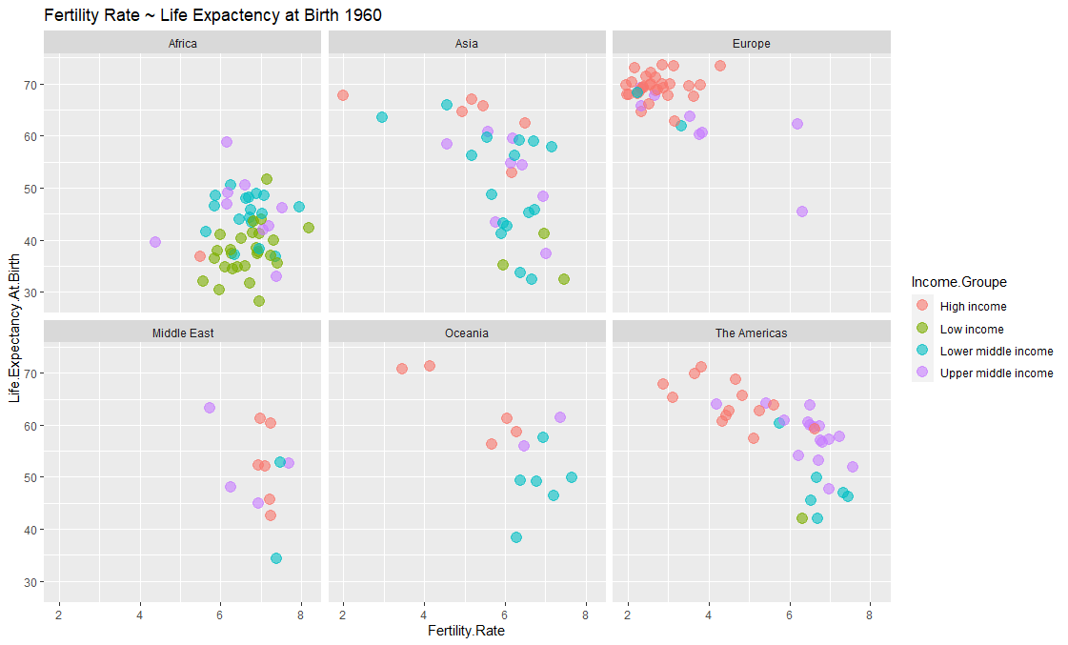
1960

Slide 21
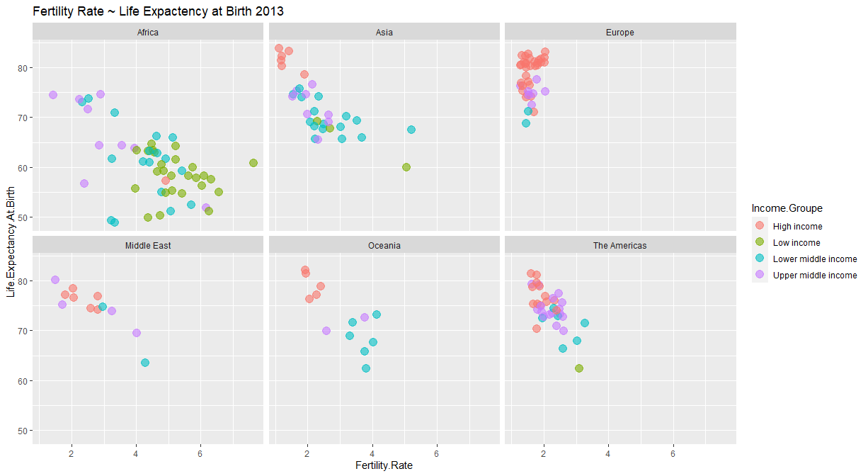
2013

Slide 22
Insights
As we can see , High income group countries tend to have a low fertility rate and a better life expectancy at birth percentage than low income group countries. And the rest of the income group data is consisting with the relation.
Part of the countries in Africa had reached a better life expectancy at birth, and lower fertility rate
While in Europe for instance, the data has approximately the same characteristics, with a better concentration.

Slide 23
Thank you For your attention.

